Slide 1
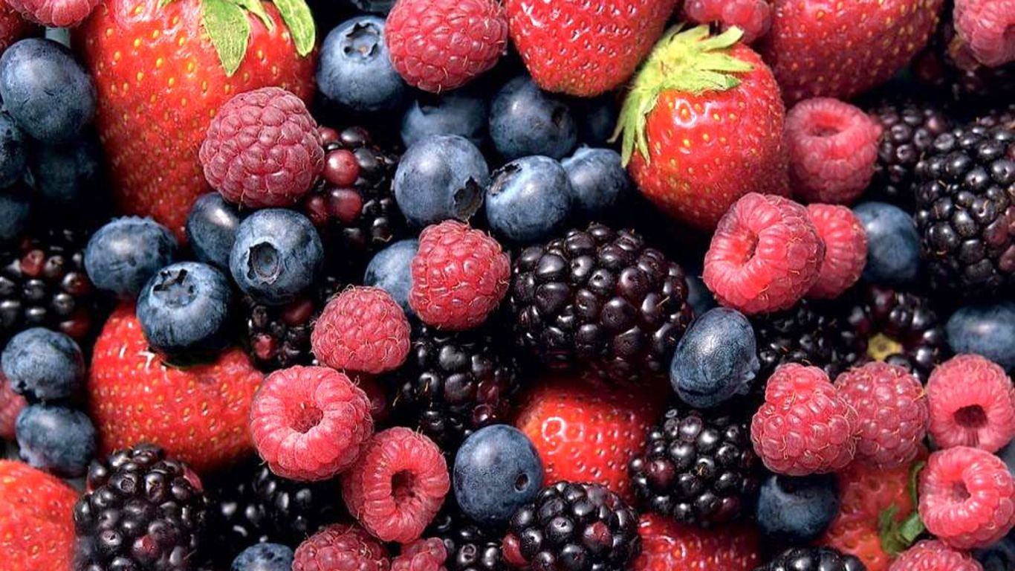
2015 Fruits, Nuts and Berries Identification
State FFA Horticulture CDE

Slide 2
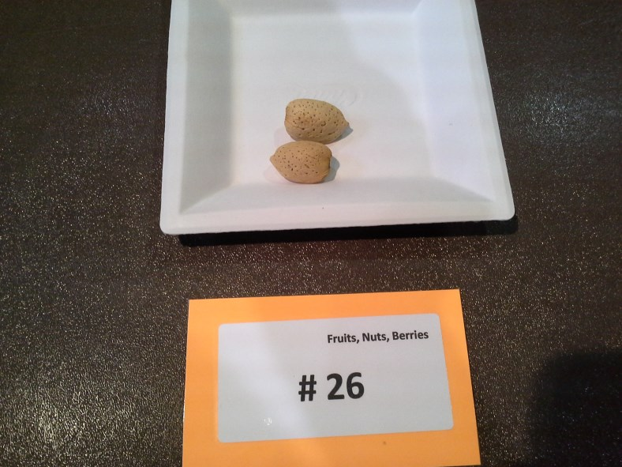
1.

Slide 3
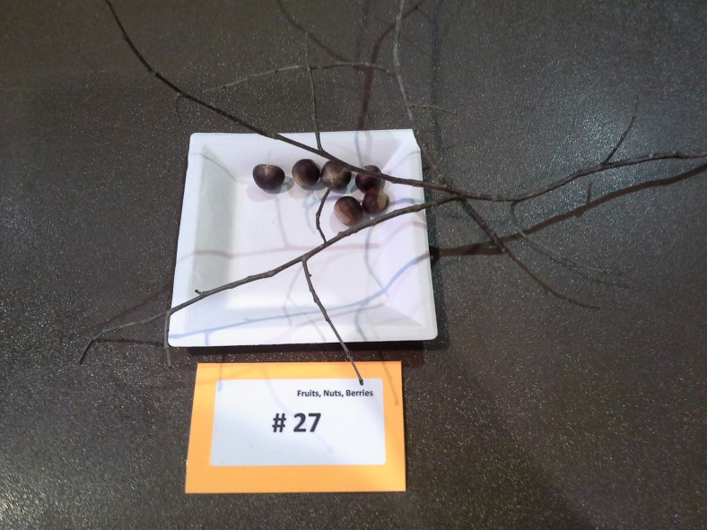
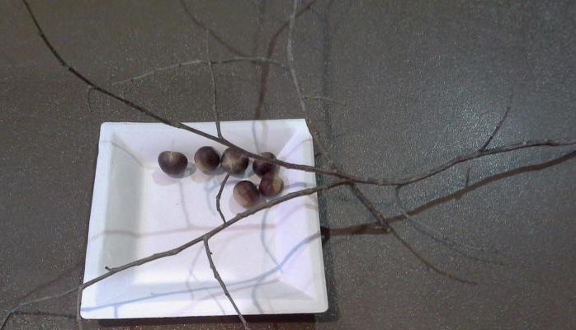
2.

Slide 4
3.

Slide 5
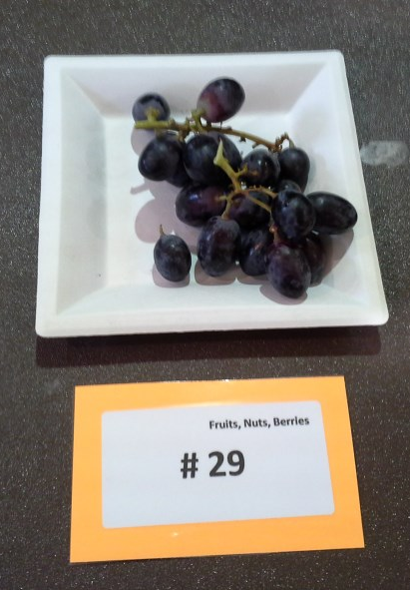
4.

Slide 6
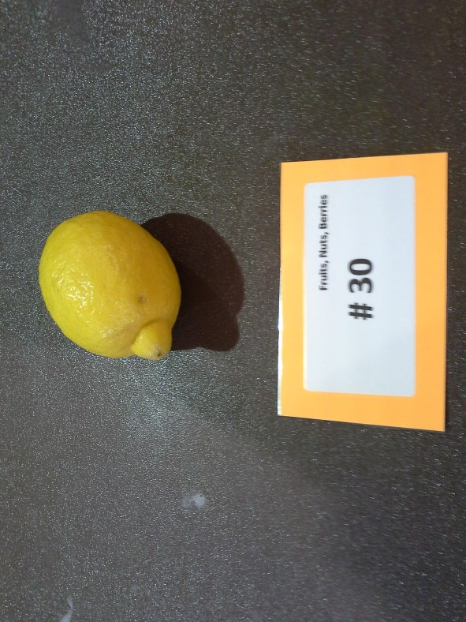
5.

Slide 7
6.

Slide 8
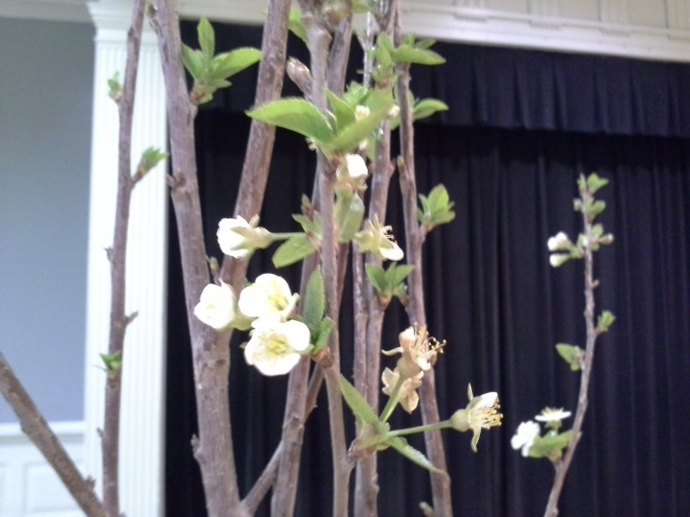
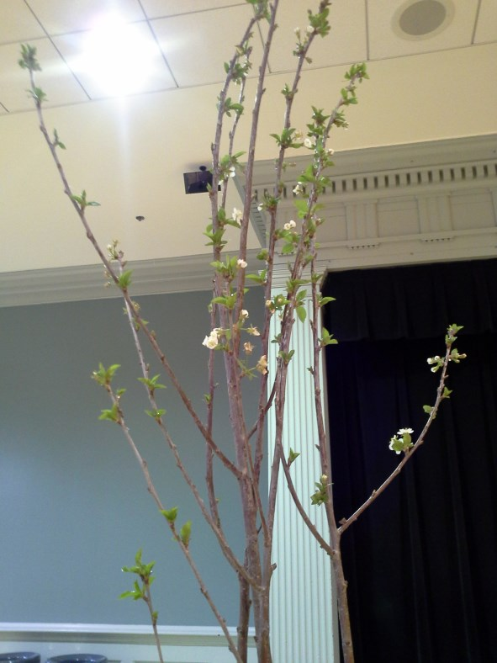
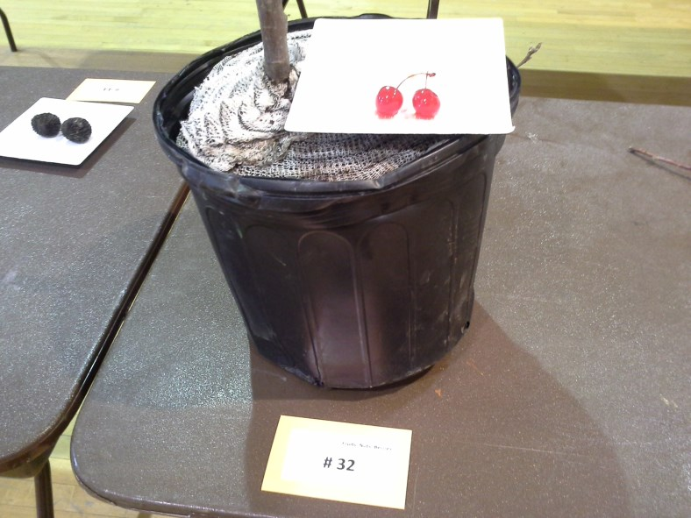
7.

Slide 9
8.

Slide 10
9.

Slide 11
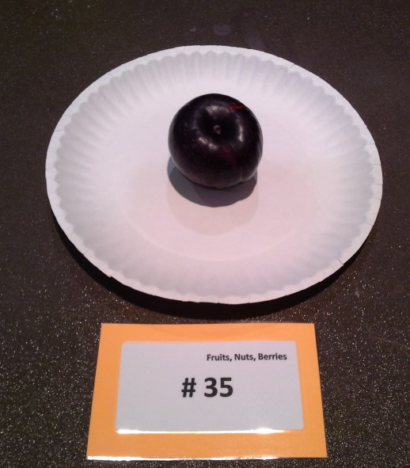
10.

Slide 12
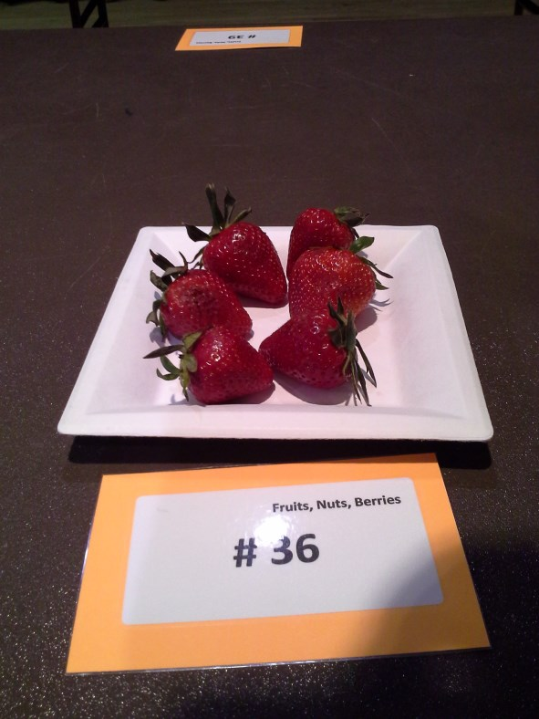
11.

Slide 13
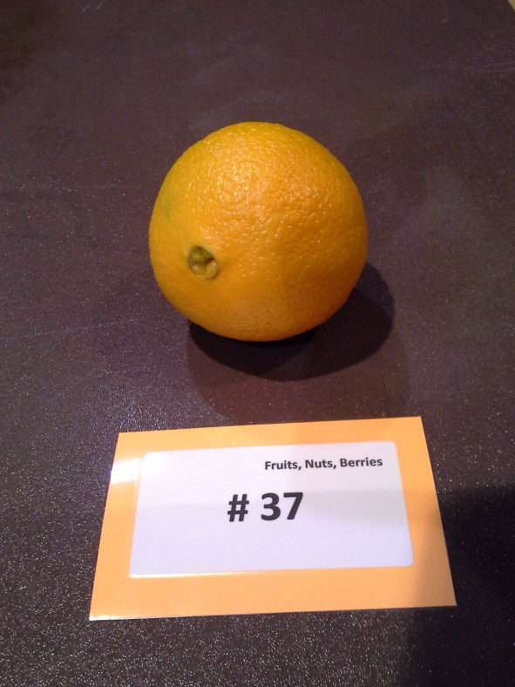
12.

Slide 14
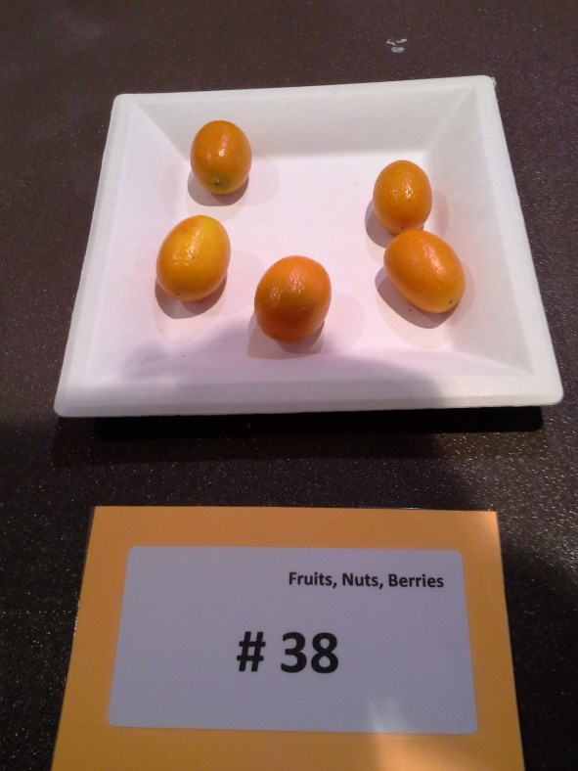
13.

Slide 15
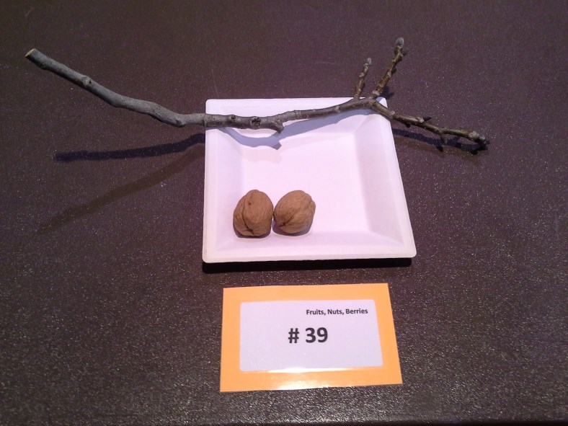
14.

Slide 16
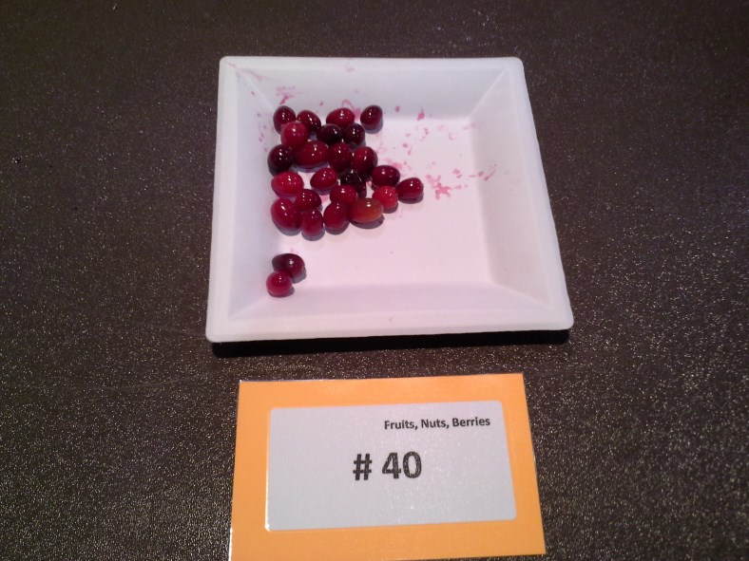
15.

Slide 17
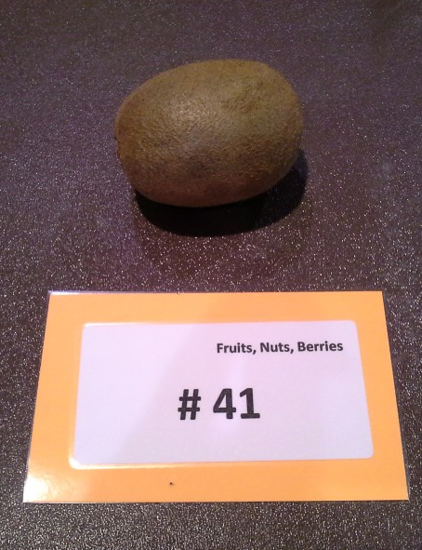
16.

Slide 18
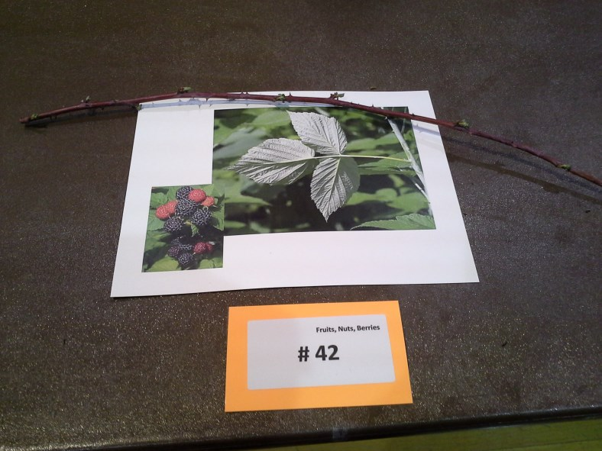
17.

Slide 19
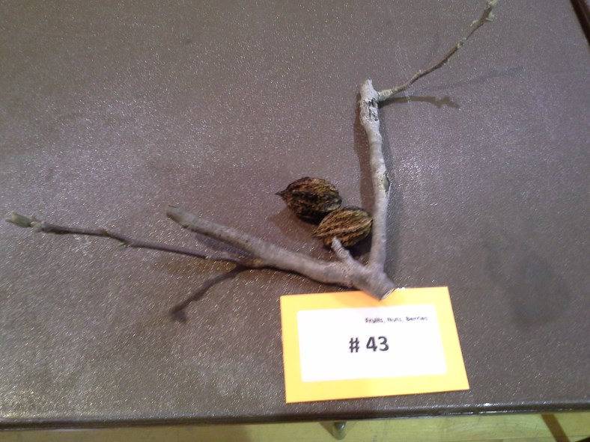
18.

Slide 20
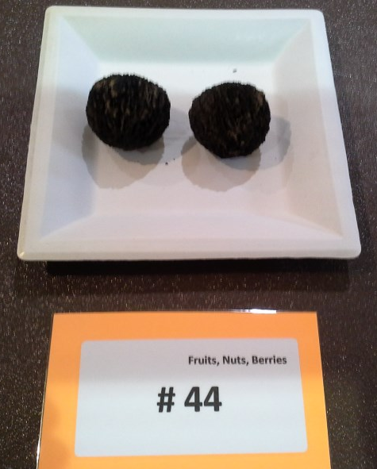
19.

Slide 21
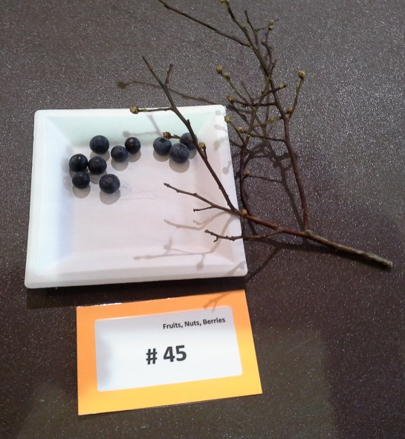
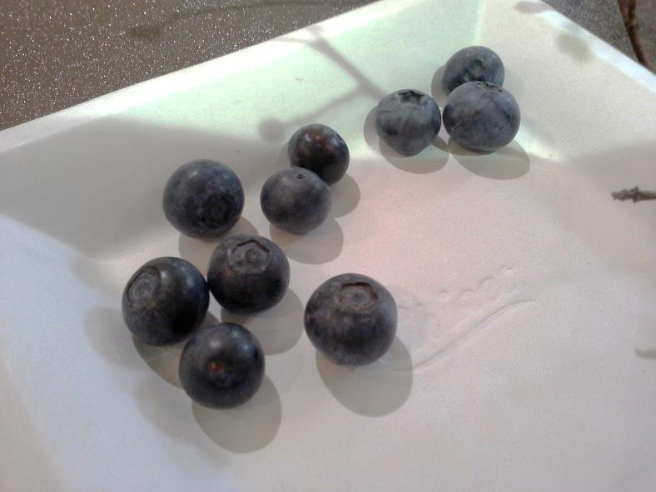
20.

Slide 22
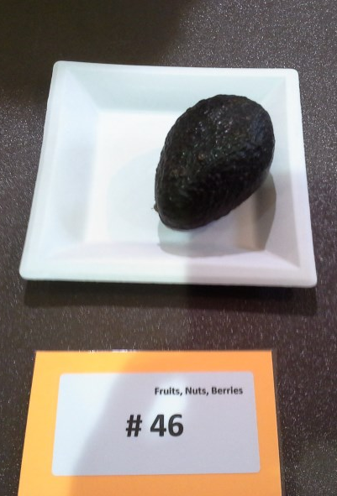
21.

Slide 23
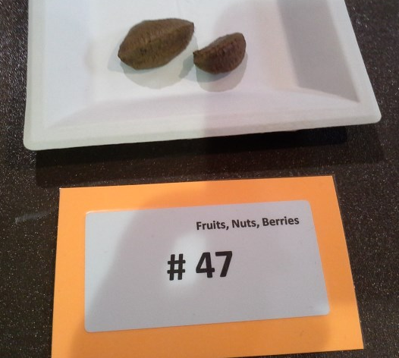
22.

Slide 24
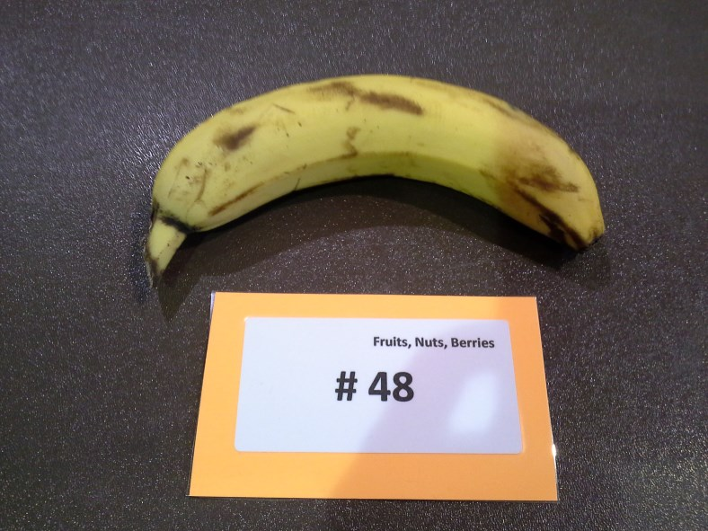
23.

Slide 25
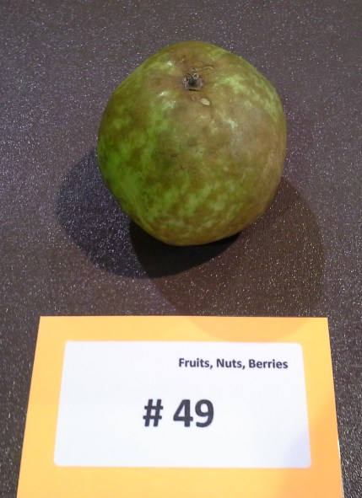
24.

Slide 26
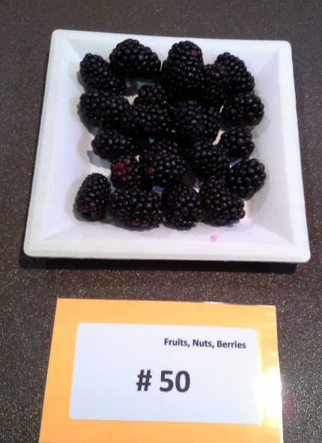
25.

Slide 27
This power point was provided for you by your Superintendent:
Susan Trice
University of Maryland Extension
Horticulture Educator/ Master Gardener Coordinator
strice@umd.edu
The University of Maryland, College of Agriculture and Natural Resources programs are open to all and will not discriminate against anyone because of race, age, sex, color, sexual orientation, physical or mental disability, religion, ancestry, or national origin, marital status, genetic information, or political affiliation, or gender identity and expression.

